Slide 1

Filter Duplicate Images | Description
Problem Statement
Expectations
Context
Undertaken Tasks
What might seem trivial and easy, Finding and weeding out duplicate images from a large dataset is complex. It has to be done with high accuracy which can be difficult for multiple images. Also, the method dictates memory consumption. To compare, if 1 image is compared with (n-1), the number of images within dataset and size of each image (as in hash method).
The worklet intends to investigate into various methods for quick and accurate duplication.
Evaluate various image duplication checking and filtering methods including Hash, etc
Evaluate Open-Source Scripts available & classify on basis of effectivity.
Write custom script to find and filter out duplication in images.
Test it for high scale and maintain accuracy.
Improve the algorithm to improve the decided parameters.
KPI
Write Research Paper stating innovative methods to find and filter duplication.
Scalable, Production Ready Script
Accuracy >98% on any given sample.
Statement
Filter Duplicate Images to optimize accuracy and memory consumption
Timeline
Work let Details
Kick Off < 2nd Month >
Abhishek Mishra
Ankit Mishra
Athira Menon
Milestone 1 < 4th Month >
Milestone 2 < 6th Month >
6
4
Duration (Months)
Members Count
Mentors
Evaluation
Design HDL & LDL
Write Python Scripts for decided functions
Apply batch & reduce time (benchmark against SOTA techniques)
Completion of Research Paper
Notes:
https://nv-tlabs.github.io/DIB-R/

Slide 2

Work-let Name: Filter Duplicate Images
Worklet Details
Worklet ID: 23RSG40SRM
College Name: SRM institute of Science and Technology
Achieved high accuracy in detecting duplicate images, ensuring reliable performance across various datasets and samples.
Ensured that the script can handle a large volume of images without performance degradation.
Reviewed existing open-source solutions.
Developed a custom script tailored to the specific needs and context of the project.
Continuously refined and optimized the algorithm based on test results and feedback.
Dataset Collection: Acquiring a suitable dataset with duplicate images posed an initial challenge, demanding meticulous curation to ensure data quality and integrity.
Workflow Optimization: Streamlining the CLIP workflow for efficiency proved challenging. However, through GPU acceleration and multithreading, we successfully reduced computation time to mere seconds, significantly enhancing productivity.
KPIs achieved till now
Any Challenges/ Issues faced
Next Steps
To write a comprehensive research paper outlining our innovative methods to detect and filter image duplication using the combination of CLIP and multithreading.
Optimization as per further feedback received (if any).
Our project focused on enhancing the efficiency of duplicate image detection utilizing the CLIP model as guided by our mentors. By implementing multithreading and leveraging GPU processing, we successfully reduced the detection time from 2-3 minutes to an average of just 20 seconds.
Key Achievements/ Outcome till now
Date: 13/06/2024

Slide 3
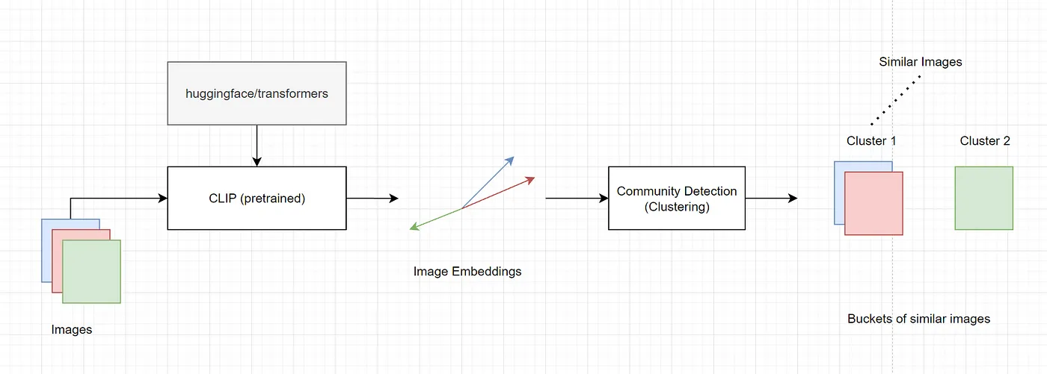
CLIP:

Slide 4

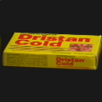
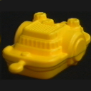
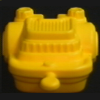


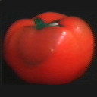
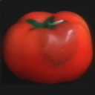


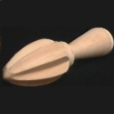
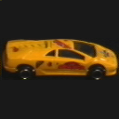
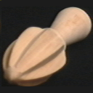
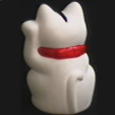
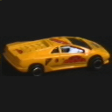
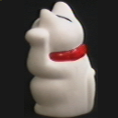
New Dataset (Columbia NDI Dataset)
7200 images

Slide 5
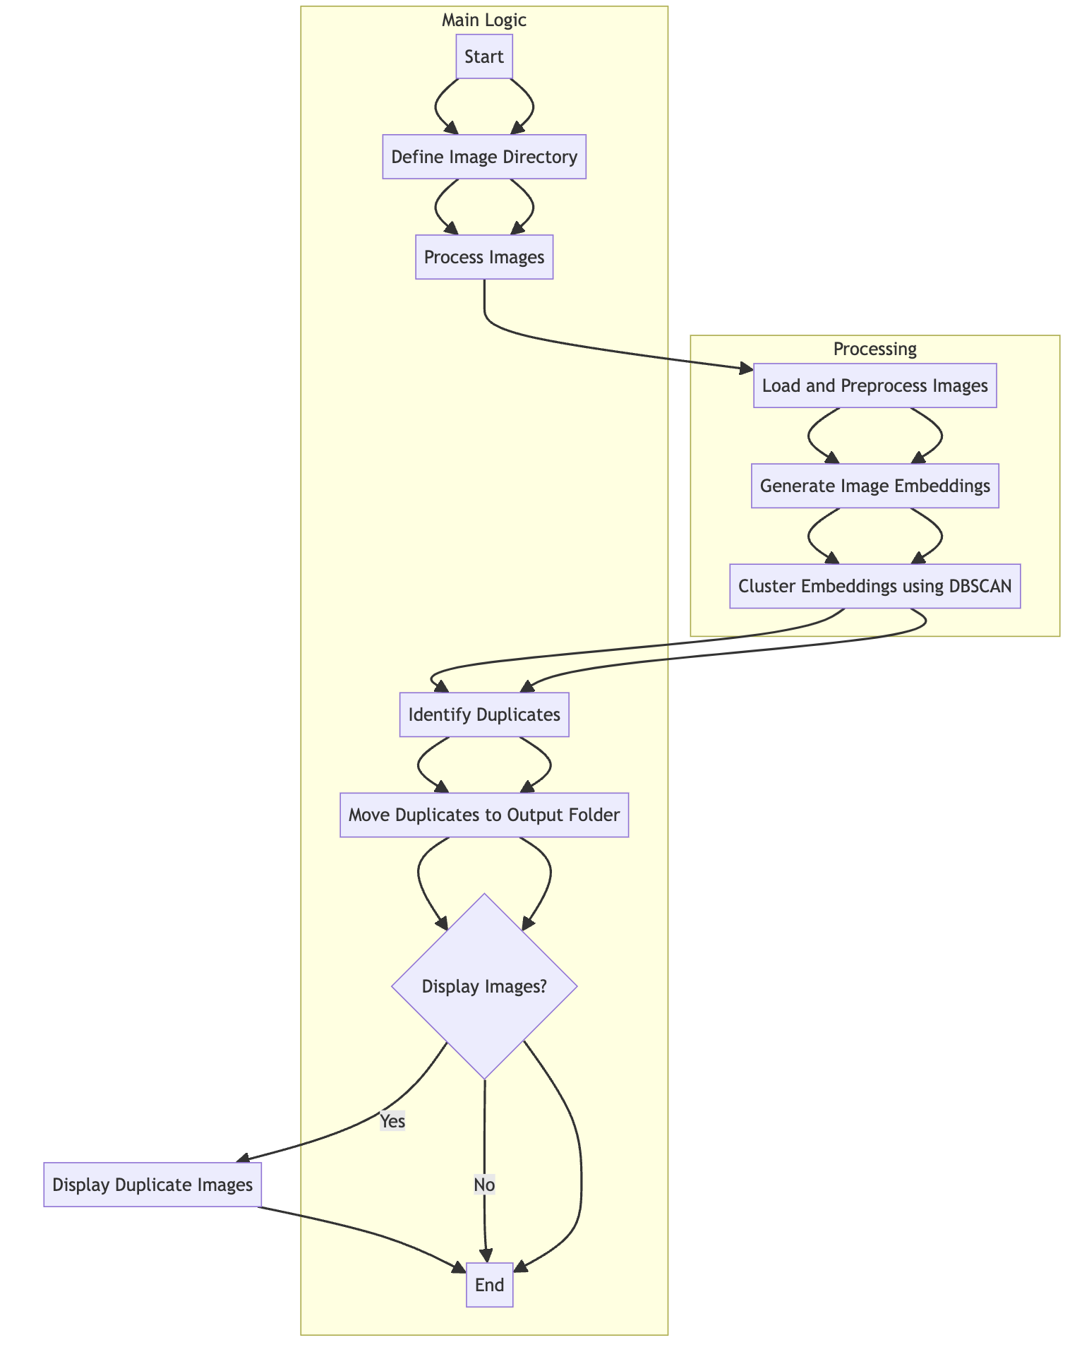
High Level Overview

Slide 6
Multithreading Optimization
Parallel Processing of Images: The ThreadPoolExecutor is used to load and preprocess images concurrently. This significantly reduces the time required for these operations compared to sequential processing, where each image would be processed one after the other.
Efficient Resource Utilization: By using multiple threads, the CPU can handle multiple tasks simultaneously, maximizing the usage of available computational resources. This leads to faster data preparation and overall better performance.

Slide 7
GPU Utilization Optimization
Fast Computation of Embeddings: The CLIP model is moved to the GPU using model.to(device), where device is set to use the GPU if available. This allows the heavy computations required for generating image embeddings to be executed much faster compared to a CPU.
Batch Processing: The model processes images in batches, taking advantage of the GPU's ability to handle large amounts of data simultaneously. This reduces the time taken to generate embeddings for a large set of images, further improving efficiency.
Reduced Latency: The GPU’s architecture is designed for high-throughput computing tasks, reducing the latency of image feature extraction. This accelerates the entire pipeline from image processing to embedding generation.

Slide 8
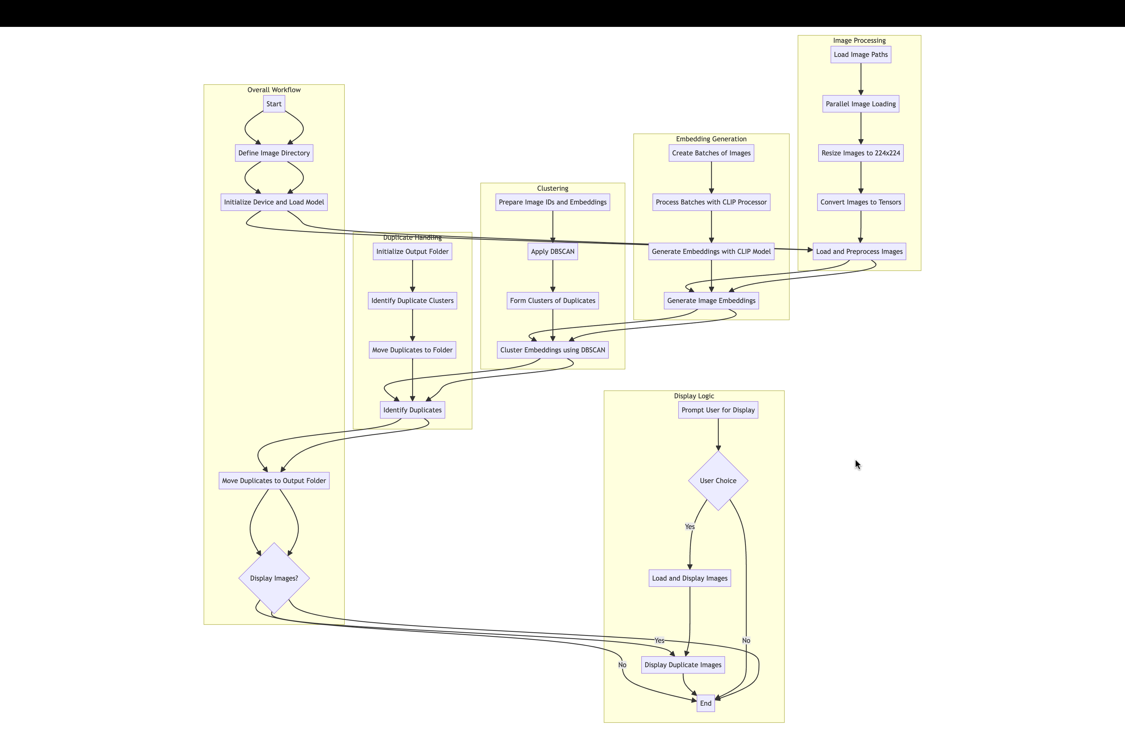
Detailed Overview

Slide 9
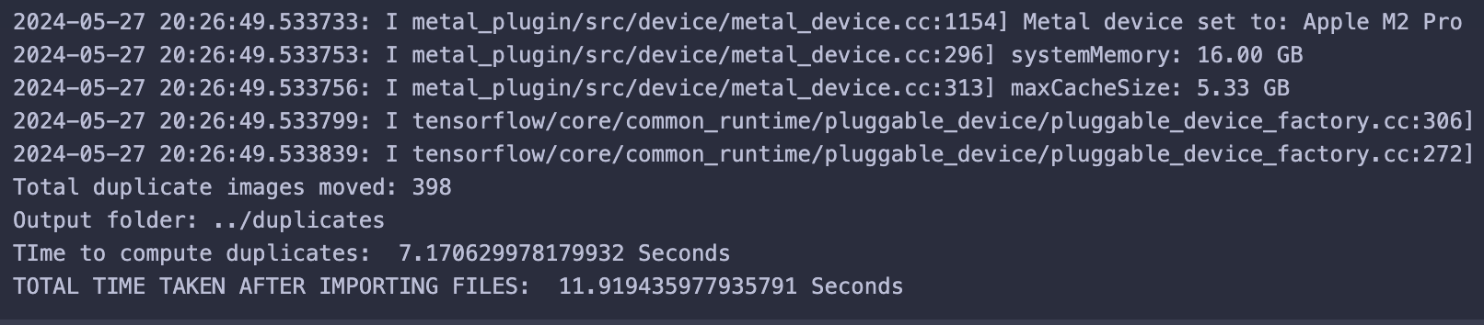
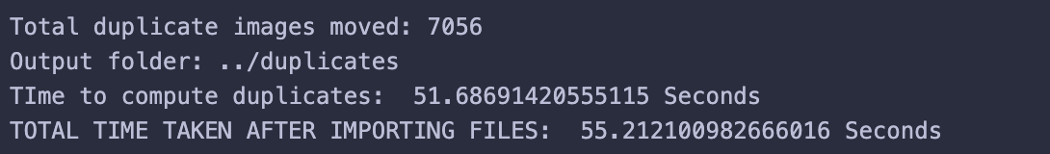
Output:
California ND dataset
Time taken to identify and store duplicates into the folder: 7.1706 seconds.
Columbia NDI Dataset
Time taken to identify and store duplicates into the folder: 51.6869 seconds.

Slide 10
Work-let Name: Filter Duplicate Images
Worklet Details
Worklet ID: 23RSG40SRM
College Name: SRM institute of Science and Technology
Columbia NDI Dataset
California ND Dataset
GITHUB: https://github.ecodesamsung.com/SRIB-PRISM/23RSG40SRM_Filter_Duplicate_Images
Resource Requirement Identified with Status
Github Repository Link and PRISM Portal Registration
Status
Any Anticipated Break (Due to exams etc)
Halt in research paper due to semester exams.
Website: https://vintage.winklerbros.net/californiaND.html
Dataset: https://drive.google.com/file/d/1u69dj5ZZTdLKdQBAZ_Tf4bLOtFtffToS/view?usp=sharing
Password: QoMEX-2013
Data Collection Information
Date: 13/06/2024

Slide 11
Work-let Name: Filter Duplicate Images
Worklet Details
Worklet ID: 23RSG40SRM
College Name: SRM institute of Science and Technology
Status and future plan:
Current status is that various models are compared and clip model on GPU gave promising results.
Future plans is to write a research paper analysing the various models on detecting the duplicate images of different sizes of different datasets.
Latest Literature Review:
Any other comment:
Suggestions and review from Samsung mentors for the work done .
Suggestions for the research paper publications( conference or Journal)
Professor Comments :
Initially the dataset size was small and detection time was more (first approach)
After applying multithreading optimization to larger dataset,
the detection time was less( the second approach seems to be better for detection)
Article | Author | Review
A Closer Look at the Robustness of Contrastive Language-Image Pre-Training (CLIP) | Weijie Tu, Weijian Deng, Tom Gedeon | study shows that it found CLIP models to have remarkable generalization capabilities across multiple challenging distribution shifts. This indicates their robustness and adaptability in diverse and challenging conditions.
Re-scoring using image-language similarity for few-shot object detection | Min Jae Jung, Seung Dae Han, Joohee Kim | The paper uses CLIP for few-shot object detection. It enhances detection by re-scoring classification scores using image-class similarities. However, its effectiveness can vary with data quality and task complexity.
Date: 13/06/2024

